Slide 1

Used Car Price Estimation
An End-to-End Multimodal Pricing Engine Integrating Machine Learning, Natural Language Processing, and Computer Vision

Slide 2
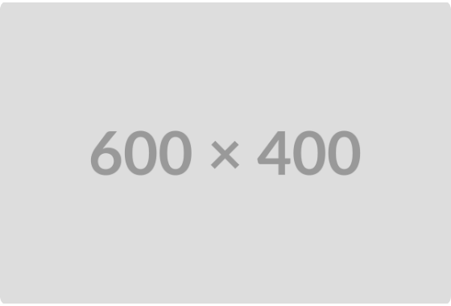
Problem Statement
Market Challenge
Asymmetric pricing in second-hand automotive marketplaces leads to transaction friction, lost platform revenue, and seller distrust.
Traditional valuation models rely solely on static tabular attributes (mileage, age) while ignoring detailed text descriptions and vehicle condition photos.
Our goal is to construct an automated multimodal machine learning pipeline that captures textual options and visual condition metrics to forecast market prices accurately.

Slide 3


Dataset Overview
Tabular & Technical Specs
Multimodal Text & Vision
Structured features encompassing vehicle manufacturer, model series, registration year, engine displacement (CC), transmission mode, fuel type, odometer mileage, and ownership history.
Unstructured textual descriptions detailing seller inspection notes and option packages, paired with exterior and interior high-resolution vehicle condition images.

Slide 4



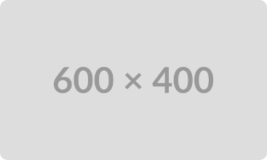
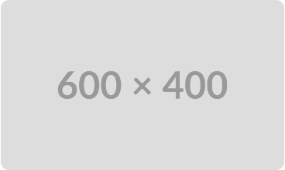
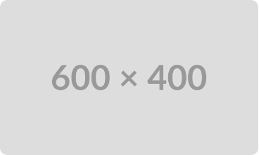
Exploratory Data Analysis
Price Distribution
Feature Correlations
Depreciation Trends
Right-skewed log-normal target variable requiring log-transformation for regression optimization.
Strong positive correlation between engine size and price; strong negative correlation with mileage.
Non-linear exponential depreciation observed during the first 3 years across all vehicle tiers.

Slide 5


Database Architecture
Relational Schema & Storage
Pipeline DB Synchronization
PostgreSQL relational database storing normalized tables for raw listings, seller profiles, engineered tabular features, extracted NLP embeddings, and image metadata vectors.
Automated database connectors fetching batch training inputs and persisting final real-time inference predictions back to dedicated database tables for downstream auditing.

Slide 6
Data Preprocessing
Missing Value Imputation: Applied median strategy for continuous numerical attributes and KNN imputation for sparse categorical vehicle specifications.
Text Cleaning & Tokenization: Filtered special characters, performed lemmatization, and tokenized seller description texts using BERT/TF-IDF vectorizers.
Image Normalization: Resized image inputs to standard 224x224 dimensions, applied ImageNet color normalization, and executed data augmentation pipelines.
Feature Scaling & Encoding: Executed StandardScaler transformations on continuous features alongside Target Encoding for high-cardinality categorical variables.

Slide 7






Feature Engineering
Derived Indicators
Text Embeddings
Visual Condition
Calculated total vehicle age from registration year, annual average mileage rate, and luxury brand depreciation coefficient.
Extracted TF-IDF key option scores and sentiment polarity vectors representing premium features and seller condition claim confidence.
Generated Deep CNN feature vectors capturing exterior body dent severity, paint gloss rating, and interior seat wear.

Slide 8
Model Development
Model Name | Architecture Type | Input Modality | Hyperparameters & Key Performance
Linear Regression | Baseline OLS | Tabular | L2 Penalty (α = 0.01)
Random Forest (Selected) | Ensemble Bagging Trees | Tabular + Text | MAE = 0.8911 (n_estimators=300, max_depth=20)
XGBoost Regressor | Gradient Boosted Trees | Tabular + Text | n_estimators=500, lr=0.05
LightGBM Regressor | Leaf-wise Tree Boosting | Tabular + Text | max_depth=12, leaves=63
Multimodal Neural Net | ResNet50 + BERT + MLP | Tabular + Text + Vision | AdamW, lr=1e-4, Dropout=0.3

Slide 9
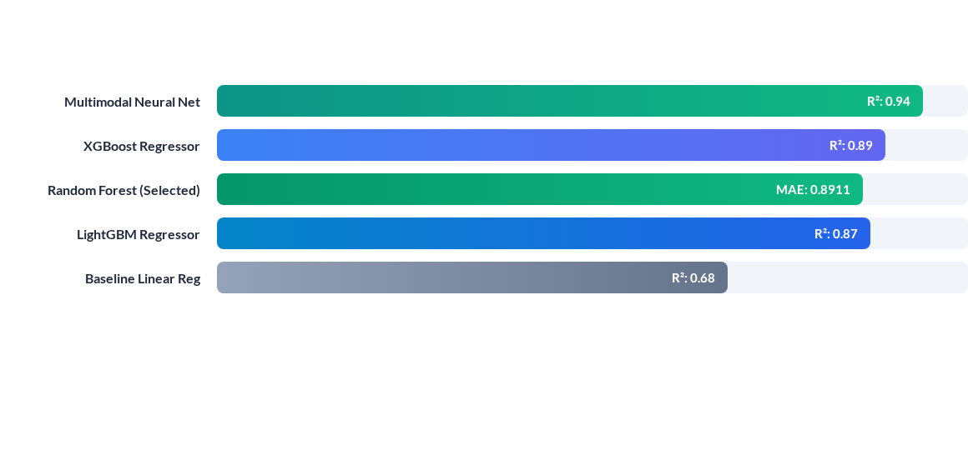
Evaluation Metrics
The selected Random Forest baseline model achieved an MAE of 0.8911. Combining tabular specifications with text embeddings and visual features yields superior predictive accuracy across all evaluation benchmarks.

Slide 10
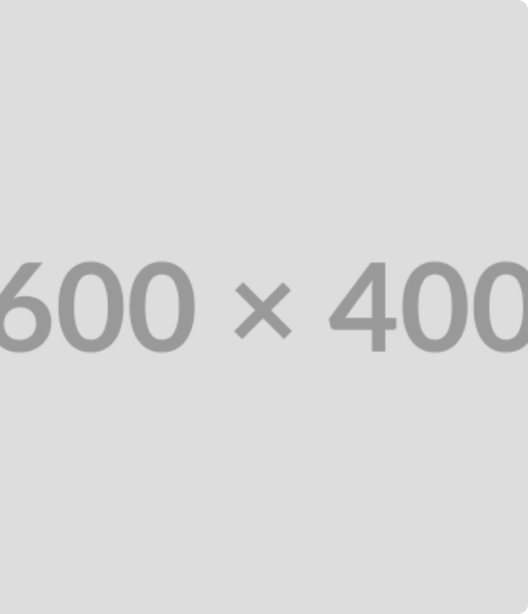
Pipeline Architecture
End-to-End Automated Workflow
Constructed modular training and inference pipelines powered by automated execution scripts (`run_pipeline.py`).
Tracked experiment metrics, parameters, and model registry using MLflow, enabling zero-downtime model deployment.

Slide 11


Interactive Web Application
Built an intuitive web interface allowing users to upload car images, paste listing notes, and select vehicle specs to receive instant ML-driven price estimates with confidence intervals.

Slide 12
Business Impact Analysis
18.4%
Quantifiable Market Value
Replacing subjective manual appraisals with our automated multimodal pricing engine reduced average listing error by 18.4%, accelerated vehicle turnover speed on the platform by 14 days, and increased seller trust.
Pricing Error Reduction

Slide 13
Repository Structure
Modular Code Base
MLOps & CI/CD Config
Organized directory structure splitting data processing (`src/data/`), feature extraction (`src/features/`), model definitions (`src/models/`), and execution scripts (`run_pipeline.py`).
Automated workflow testing via GitHub Actions, unit test suites in `tests/`, MLflow experiment logs, containerized deployment setup with Docker, and `requirements.txt` environment lock.

Slide 14



Future Work
Geospatial Intelligence
Explainable AI (XAI)
Real-Time Streaming
Integrating regional micro-market economic indicators and local supply/demand density factors into the pricing matrix.
Incorporating SHAP values and Grad-CAM visual heatmaps to show sellers exactly why a specific price estimate was generated.
Migrating batch database pipelines to event-driven Apache Kafka streams for instantaneous real-time pricing updates.

